Slide 1



Cybersecurity Training Project: 60 Hours of Attack and Defense Practice
Student Names: [nooraddin], [mohammed Amar], [Mohammed abdualwahed], [Anas adel]
Institution: Al-Nasser University & SccCollege Training Program
Instructor: Dr. [Nashwan althoubhani]
Date: [20/8/2025]

Slide 2
What We Will Cover
Our Goals
Our Lab Setup
The Defense Team Tools
The Attack Team Tools
How the Attack Worked
Skills We Learned
Problems We Faced
Conclusion

Slide 3
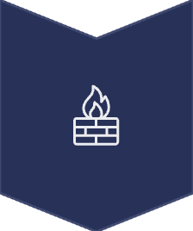




Our Goals
To build a computer lab with two separate networks for security practice.
To install and use tools for both computer defense and attack.
To run a practice attack to find weak spots.
To learn how to find and study attacks on a network.
To report on what we learned in our 60 hours of training.

Slide 4
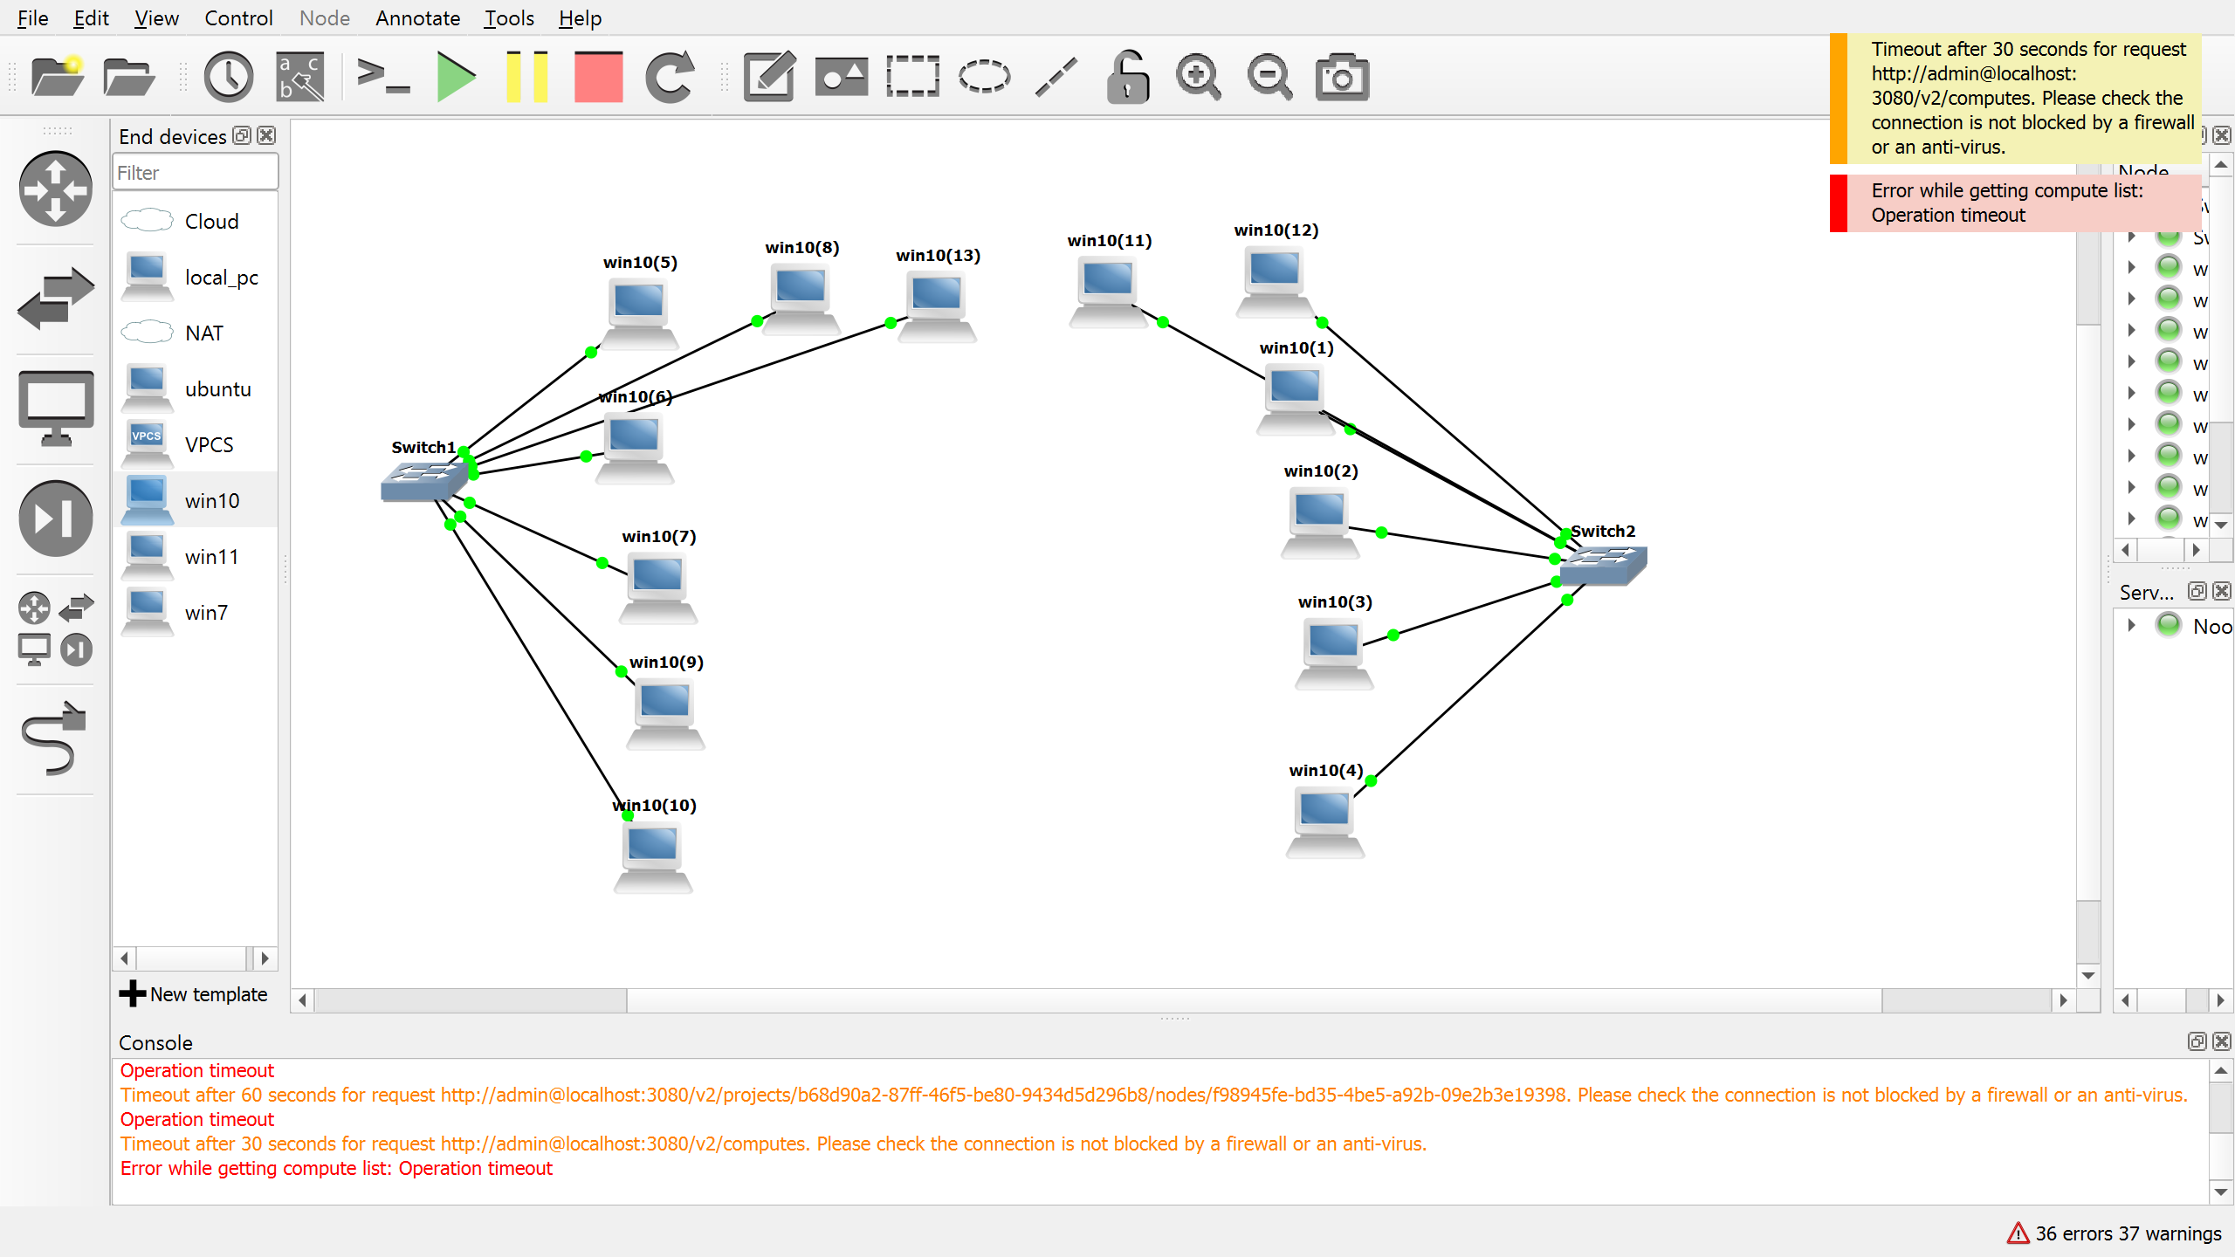
Our Lab Setup
م
What We Used:
16 PCs, 2 Network Switches and we install kali and Metasploitable 2
and ubuntu. In our lab in vm and we connect each devices
How We Split It:
The lab was split into two teams:
Defense Network: 192.168.1.0/24
Attack Network: 192.168.2.0/24
The Target:
We put a weak computer system (Metasploitable 2) on the network to practice on.

Slide 5




Defense Team Tools
OpenVAS / Nessus: "The Scanners."
Snort: "The Guard."
We used these to scan our computers to find problems before an attacker could.
We used Snort to watch the network for any strange or bad activity.
OpenCTI: "The Information Center."
Elasticsearch & Kibana: "The Log Keepers."
This tool helped us keep track of information about different computer threats.
We wanted to use these to collect all computer logs in one place to study them. but we have problem by certificate

Slide 6



Attack Team Tools
Operating System: Kali Linux
Nmap: "The Detective."
Metasploit Framework (msfconsole): "The Master Key."
We used Nmap first to find computers on the network and see what they were running.
A common tool for security testing.
We used this tool to attack the weak spots we found with Nmap.

Slide 7



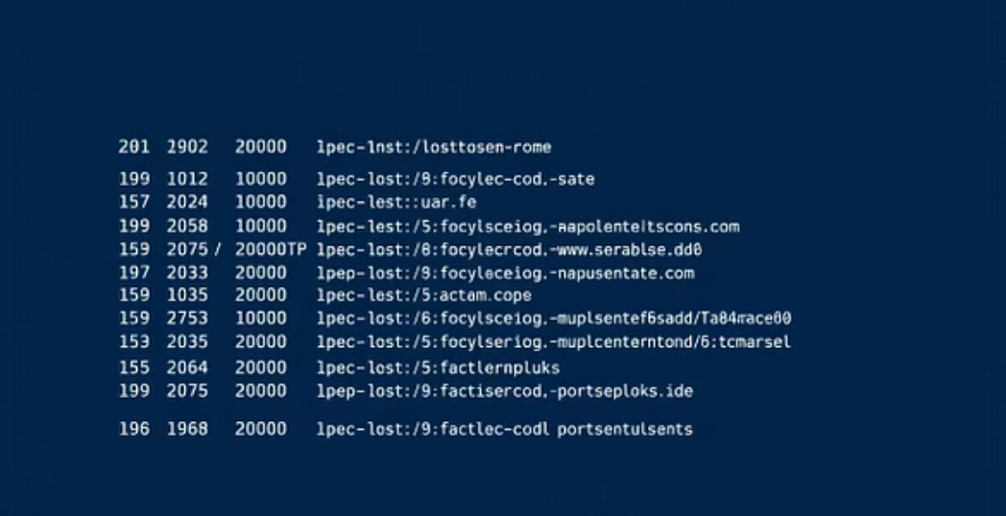
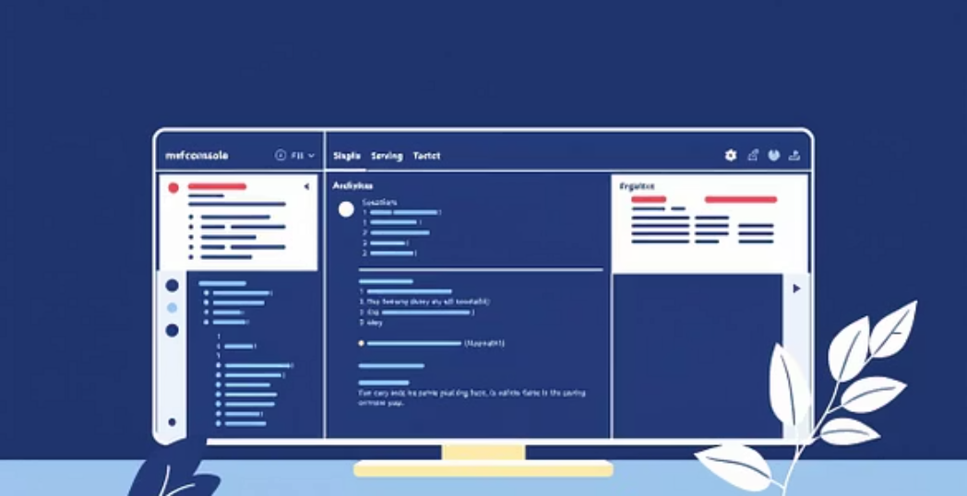
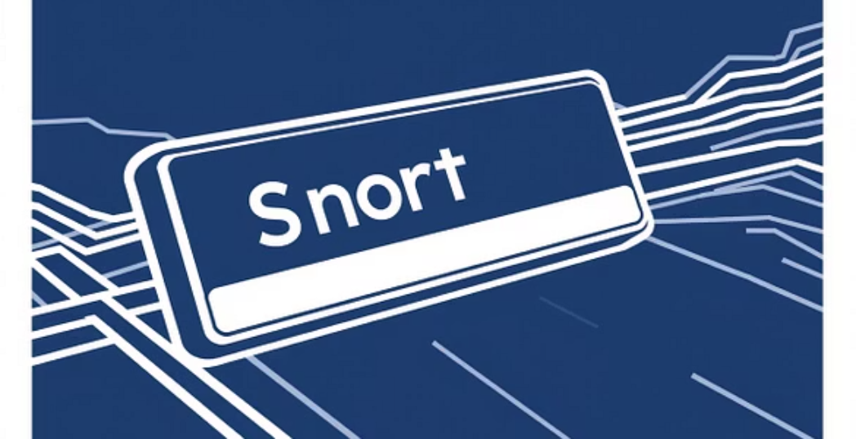
How the Attack Worked
Step 1: Finding the Target (Attack Team)
Step 2: Attacking the Target (Attack Team)
Step 3: Finding the Attack (Defense Team)
We used Nmap from the attack network (192.168.2.0) to scan the defense network (192.168.1.0).
We used msfconsole to launch an attack on one of the weak spots.
At the same time, Snort on the defense network saw the attack.
Result: The attack worked, and we got control of the target computer.
Result: Snort created an alert to tell the defense team about the attack.
Result: We found the weak computer (Metasploitable 2) and its open ports.

Slide 8
What We Learned in 60 Hours
Computer Skills:
Teamwork Skills:
Building the Network: We made two separate computer networks and learned how to use IP addresses.
Working Together: We learned to talk and work together as an attack team and a defense team.
Solving Problems: We learned how to fix computer problems, like network errors.
Attacking the Target: We used Nmap and Metasploit to practice attacking a computer.
Making Plans: We learned to look at information from scans and decide on the best way to attack.
Defending the Network: We used Snort to watch the network and find attacks as they happened.
Finding Weaknesses: We used Nessus and OpenVAS to find problems in our systems.

Slide 9

Problems We Faced
Problem:
Setting up Elasticsearch & Kibana was hard because of security certificate errors.
What We Learned:
Even though we didn't finish, we learned that security certificates are very important and that we need to read instructions carefully.
Problem:
Making sure all the computers could talk to each other on the network.
Solution:
We checked all the IP address settings one by one until it worked. This helped us get better at networking.

Slide 10
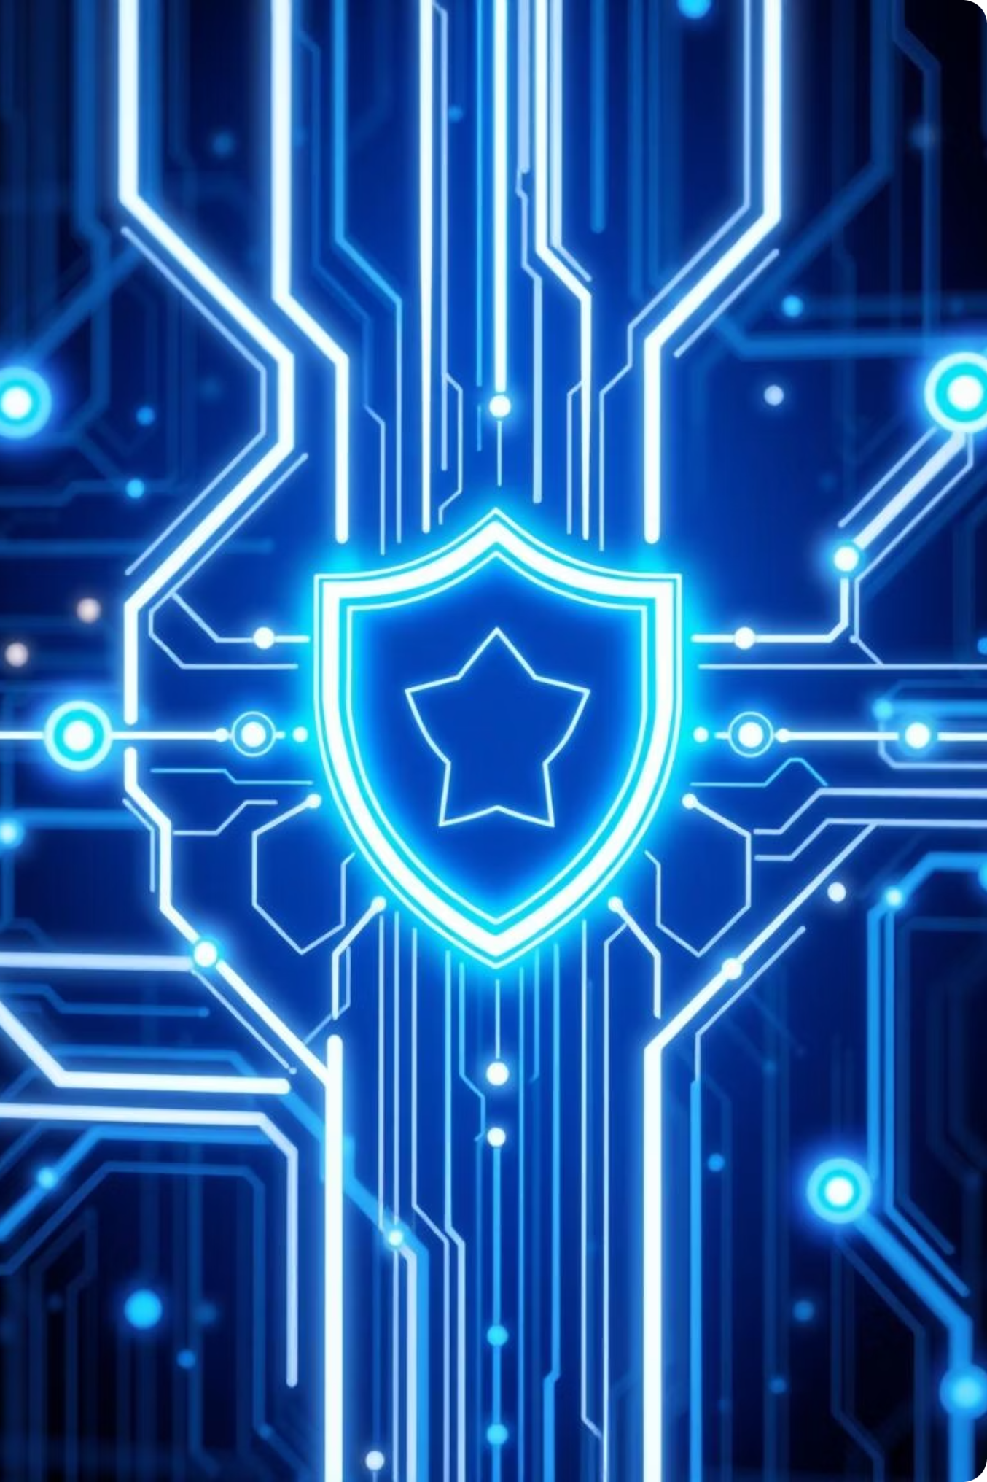
What We Learned & Next Steps
In 60 hours, we built a working cybersecurity lab.
We got real practice with important tools for attacking and defending a network.
This project helped us take what we learned in class and use it in a real way.
Next Steps: We want to finish setting up Kibana and try more advanced attacks and defenses.

Slide 11
tt
Thanks any questions?

